Slide 1

Indian Stock Market Performance amid Covid-19

Slide 2
Objective
Analyze the Impact of COVID pandemic on the Indian stock market.
The COVID pandemic has adversely impacted the world and has created a sustainability crisis. In our study we examine the impact created by COVID pandemic on the Indian stock market.

Slide 3
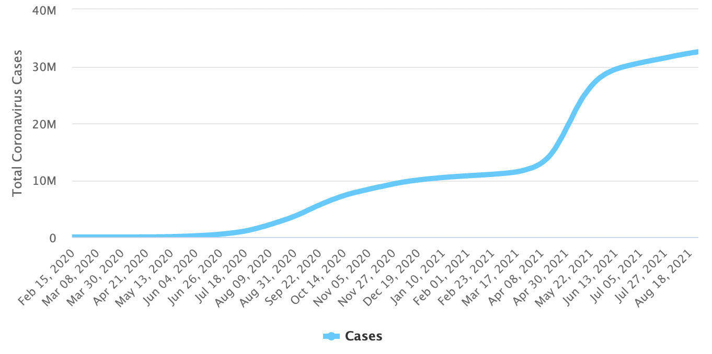
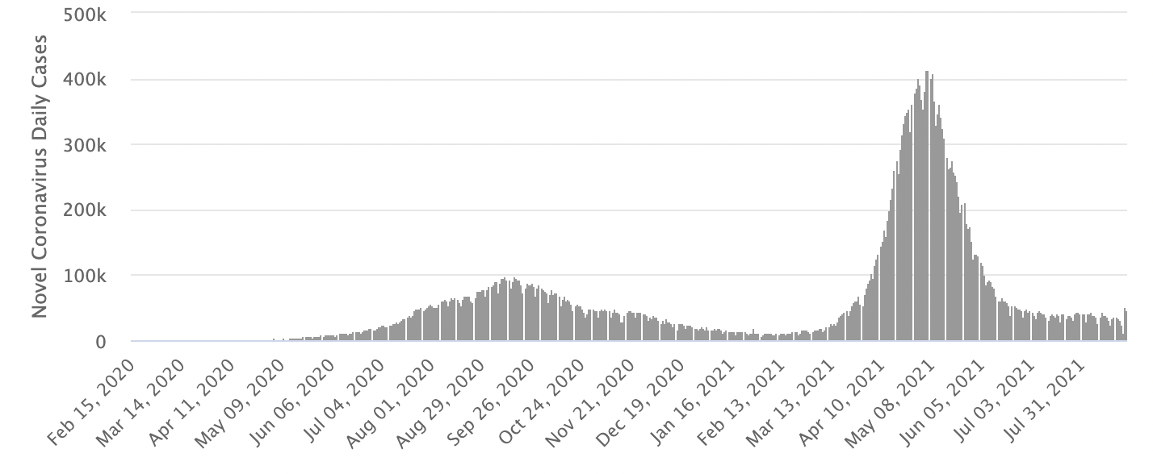
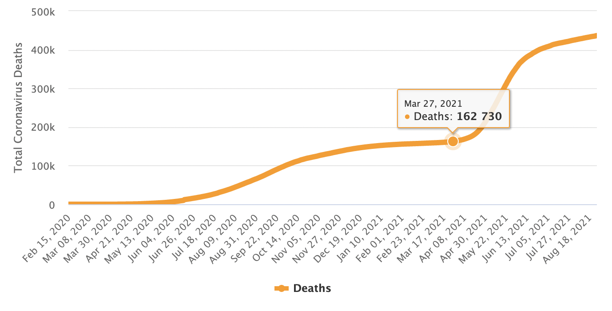
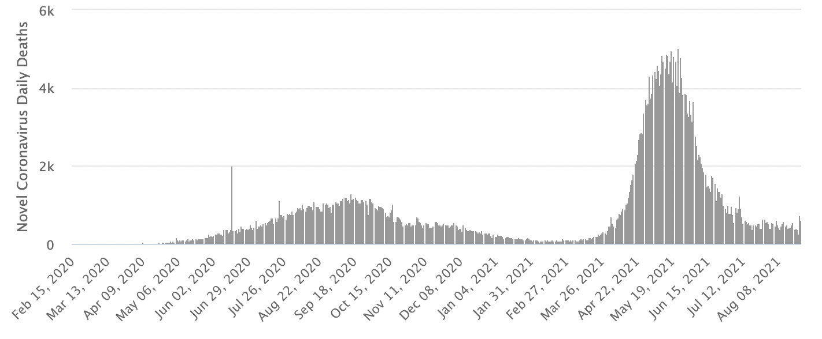
Total Cases
Total Daily Cases
Total Deaths
Total Daily Deaths

Slide 4
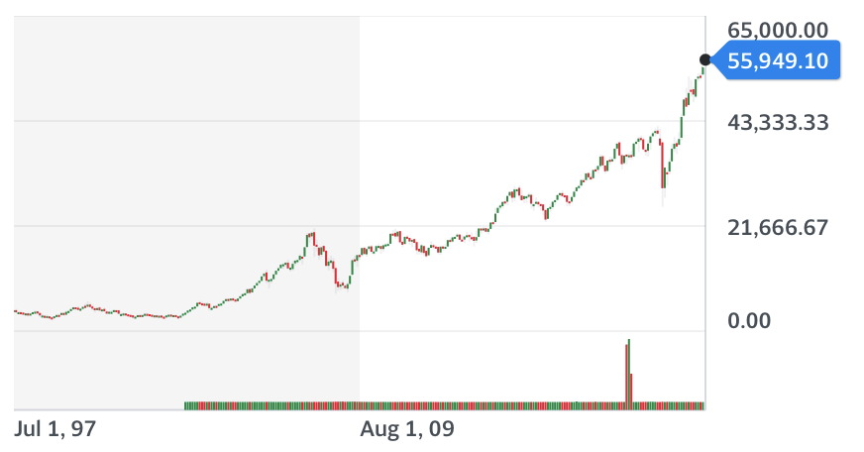
Dependent variable
There are several indexes that can be referred to judge the performance of the Indian stock market. In our analysis we have considered Bombay Stock Exchange’s Sensex.
The BSE SENSEX is a free-float market-weighted stock market index of 30 well-established and financially sound companies listed on the Bombay Stock Exchange.
Movement of Sensex across the years

Slide 5
Independent Variable (1/3)
Cases – Denotes the number of daily new COVID cases on a given day in India. Increase in COVID cases the impacts the economic activities adversely which lead to a poorer Indian stock market performance.
Deaths – Denotes the number of daily deaths due to COVID on a given day in India. Increase in deaths due to COVID impacts the economic activities adversely which lead to a poorer Indian stock market performance.
Cured – Denotes the number of people that have been cured of COVID on a given day in India. Increase in cured cases impacts the economic activities positively which lead to a better Indian stock market performance.
Vaccine - Denotes the number of people that have been fully vaccinated against COVID on a given day in India. Increase in vaccinated people impacts the economic activities positively which lead to a better Indian stock market performance.
Lockdown – This a categorical variable which represents whether India was under national lockdown. Lockdown = 1 represents that India was under national lockdown and Lockdown = 0 represents that India was either under partial lockdown or no lockdown.

Slide 6
Independent Variable (2/3)
Wave – Denotes the COVID wave number in India.
Nasdaq - Nasdaq Composite Index The Nasdaq Composite is a stock market index that includes almost all stocks listed on the Nasdaq stock exchange. Chen, H., Lobo, B. J., & Wong, W.K. (2006) has also observed that U.S. stock market dominates Indian stock market.
FII – Net value traded by foreign institutional investor in the Indian stock market. Increase in FII inflow generally leads to raise in stock market and outflow leads to downfall in stock market.
DII – Net value traded by domestic institutional investor in the Indian stock market. Increase in DII inflow generally leads to decrease in stock market and outflow leads to rise in stock market. Institutional investors are risk averse and this reduces the liquidity in the market.
OilPrice – The Europe Brent Spot Price in US Dollars per Barrel. Increase in crude oil prices leads to increase in manufacturing costs for the companies which directly impacts their profitability.

Slide 7
Independent Variable (3/3)
CPI – Consumer Price Index is the weighted average pieces of a basket of goods . Increase in CPI shows a bullish economy and hence a boost in stock market
Exchange rate – Exchange rate with respect to U.S. dollars.
Economic growth rate – It is the rate of change of GDP of India. Higher economic growth means higher future income and dividends. Hence a booming stock market when economic growth is higher
Inflation – Rate of change of inflation. Stocks are generally volatile during periods of higher inflation
Repo – It is the rate at which RBI lends to the bank. Higher repo rate implies higher cost of borrowing leading to slower growth in the economy.
Reverse repo – the rate which RBI pays back to the bank. Generally, repo and reverse repo are related.
IIP – Index of Industrial Production is an economic indicator of the manufacturing sector. Strong IIP indicates healthy manufacturing industry and hence a strong stock market

Slide 8


Missing variables?
CPI (Consumer Price Index)
Inflation
GDP of the country
Economic growth
#We have included a proxy – India 3 month bond yield – to accommodate the missing variables
Investor’s Sentiment

Slide 9
Modifications in independent variables
We have made the following modifications to our data before doing our analysis:
Removed data for non-operational days – Since we do no have the Sensex data for days when the market is closed, we have not considered these days in our analysis.
Due to difference in periodicity of macro economic and the Sensex data, we could not consider them in our analysis. To overcome this and prevent omitted variable bias we have included India 3-Month Bond Yield
Since we are analyzing time series data we would need to check for stationarity before moving ahead with the analysis.

Slide 10
Descriptive statistics
Start date: 12th March 2020
End date: 29th January 2021
 | Mean | Standard Error | Median | Standard Deviation | Kurtosis | Skewness | Range | Minimum | Maximum
sensex | 38345.89 | 393.15 | 38188.00 | 5857.76 | -0.80 | 0.19 | 23810.88 | 25981.24 | 49792.12
cases | 33213.48 | 1881.11 | 25692.50 | 28027.93 | -0.83 | 0.57 | 97894.00 | 0.00 | 97894.00
deaths | 483.77 | 25.06 | 446.50 | 373.42 | 0.00 | 0.65 | 2003.00 | 0.00 | 2003.00
cured | 32411.65 | 1892.89 | 25924.00 | 28203.46 | -1.06 | 0.47 | 101468.00 | 0.00 | 101468.00
lockdown | 0.21 | 0.03 | 0.00 | 0.41 | 0.02 | 1.42 | 1.00 | 0.00 | 1.00
OilPrice | 38.41 | 0.81 | 40.29 | 12.04 | 19.66 | 0.30 | 165.39 | -37.63 | 127.76
FII | 504.98 | 171.63 | 361.96 | 2557.17 | 12.43 | 1.88 | 25084.07 | -6027.58 | 19056.49
DII | -377.66 | 103.05 | -480.80 | 1535.48 | 1.79 | 0.70 | 10836.80 | -4968.90 | 5867.90
ex_rate | 74.53 | 0.07 | 74.56 | 1.05 | -1.11 | 0.25 | 4.11 | 72.84 | 76.95
Nasdaq | 10722.59 | 109.01 | 10966.00 | 1624.20 | -0.44 | -0.45 | 6775.32 | 6860.67 | 13635.99
bond_yield | 3.39 | 0.03 | 3.29 | 0.43 | 5.52 | 2.38 | 2.35 | 2.70 | 5.05

Slide 11
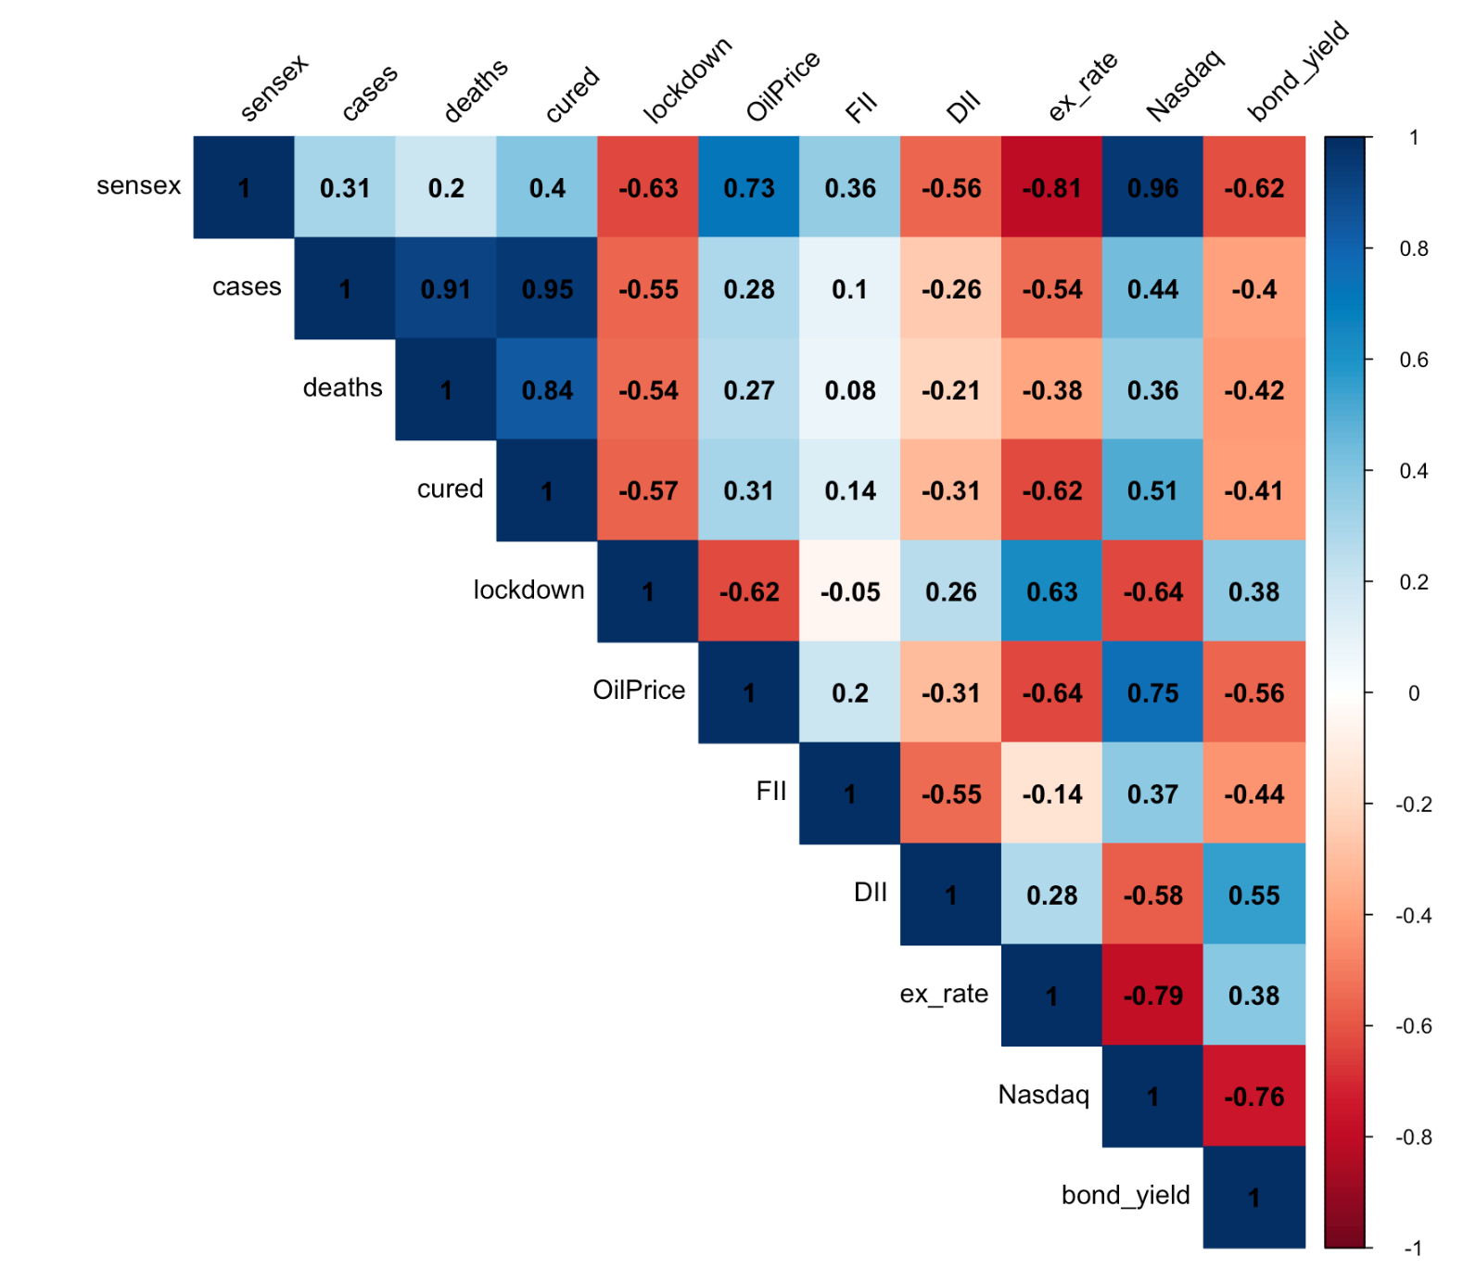
Correlation

Slide 12
Specifications
Relevant independent variables:
deaths and cured are highly correlated with the number of COVID cases and as the number of COVID cases rise both the numbers will follow suit. They independently do not contribute significant value in determining the movement of Sensex and hence we have dropped them from the analysis.
Even though Nasdaq, ex_rate and OilPrice have a high correlation with sensex , theory suggests that they significantly impact the movement of Sensex.
We have excluded the variable DII from our analysis. A study in the IUJ Journal Of Management shows that Sensex movement impacts the investment strategies of DIIs but, on contrary the investments made by DIIs are not making any impact on the movement of Sensex using Granger Causality Block Exogeneity Test.

Slide 13
Independent Variables summary
Variable Name | Variable type | Unit | Frequency | Estimator’s Expected Sign
Cases | Quantitative | - | Daily | -ve
Lockdown | Categorical | - | - | -ve
Exchange rate | Quantitative | INR/$ | Daily | -ve
Nasdaq | Quantitative | - | Daily | +ve
FII | Quantitative | INR Crores | Daily | +ve
Crude | Quantitative | USD/barrel | Daily | -ve
Bond Yield | Quantitative | Percentage | Daily | +ve

Slide 14
Functional Form
s$ensex= β_{1}+β_{2}Cases+β_{3}Lockdown+β_{4}ex_rate+β_{5}Nasdaq+$ $β_{6}FII+β_{7}Crude+β_{8}BondYield+u$

Slide 15
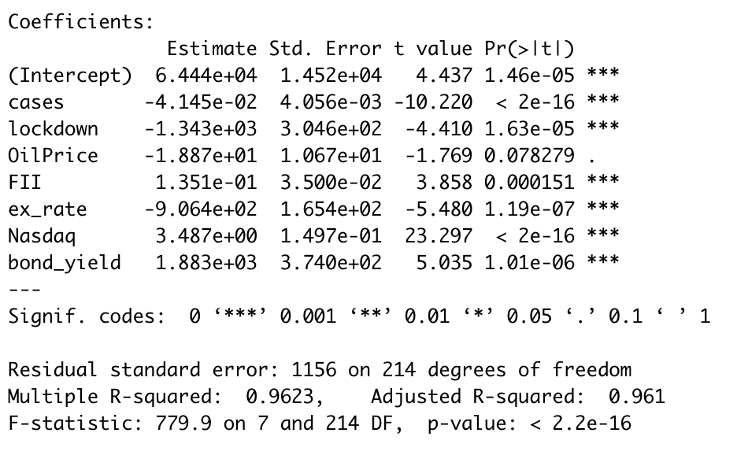
Our first regression…
Independent variables other than OilPrice are statistically significant in determining the movement of Sensex
The sign of the estimators is as we had hypothesized from theory
We need to now check for multicollinearity, heteroskedasticity and autocorrelation in our regression.
Sensex $=64440 −0.041∗Cases −1343.3∗Lockdown−906.43∗Exchange rate+3.487∗Nasdaq+$ 0.135$∗FII −0.1887∗Crude Oil+1883.2∗Bond Yield$

Slide 16
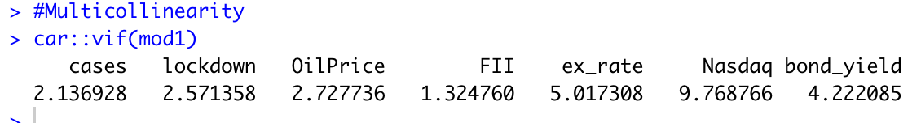

Multicollinearity
Test for multicollinearity
Variance Inflating Factor (VIF): Degree to which the variance of the OLS estimator is inflated because of collinearity
$$VIF=\frac{1}{1 −r_{23}^{2}};{ r}_{23}is the coefficient of correlation between X2 and X3$$
Since the Variance Inflation Factor (VIF) is lower than 10 for all the variables we can say
that there isn’t very high collinearity.
Variables ex_rate, bond_yield and Nasdaq have high VIF and they could have imperfect collinearity but as with multicollinearity, we believe doing nothing is best!

Slide 17
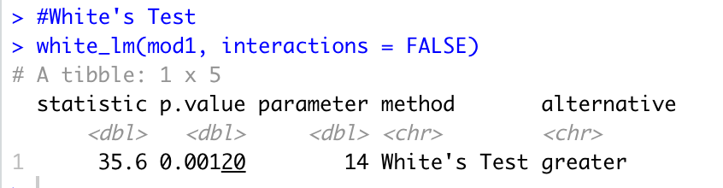
Heteroskedasticity
Test for heteroskedasticity
White’s test for heteroskedasticity:
Regress the squared residuals on the regressors, the squared terms of these regressors, and the pair-wise cross-product term of each regressor
Obtain the R2 value from this regression and multiply it by the number of observations
Hypothesis testing H₀ – there is homoscedasticity H_{a} – there is evidence of heteroskedasticity
Since p-value is lower than alpha (0.05) we reject the null hypothesis and conclude that there is evidence of heteroskedasticity

Slide 18
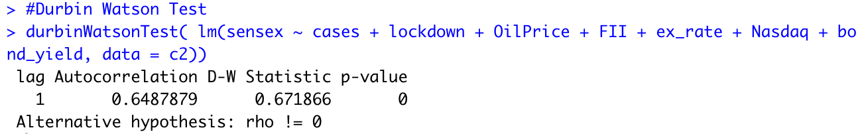

Autocorrelation
Test for Autocorrelation
Durbin Watson test:
Test statistic = d = $\frac{\sum_{t=2}^{t=n}{{\left(et −et−1\right)}^{2}}}{\sum_{t=2}^{t=n}{{et}^{2}}}$
If d < d_{L}, there probably is evidence of positive autocorrelation
If d > d_{U}, there probably is no evidence of positive autocorrelation
If d_{L} < d < d_{U}, no definite conclusion about positive autocorrelation
If d_{U} < d < 4 - d_{U}, probably there is no evidence of positive or negative autocorrelation
For N = 222 and K = 8
d_{L}(N = 200) = 1.582 and d_{L}(N = 250) = 1.634
d < d_{L}, there probably is evidence of positive autocorrelation

Slide 19
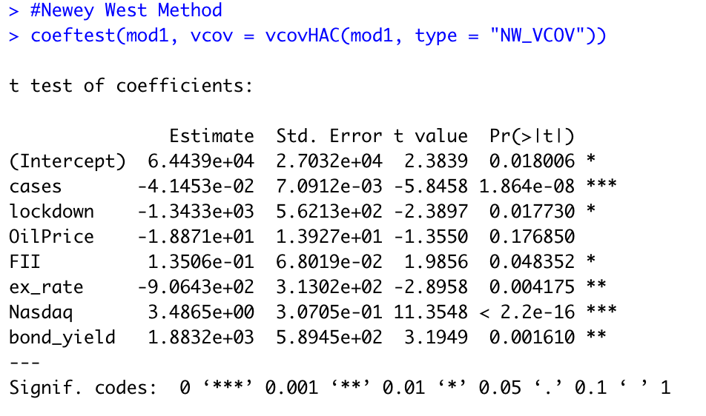
Correcting for heteroskedasticity and autocorrelation…
Newey-West Method to correct for heteroskedasticity and autocorrelation
Independent variables other than OilPrice are statistically significant in determining the movement of Sensex
After correcting for heteroskedasticity and autocorrelation in our regression, we can rely on the hypothesis testing to determine the significance level of variables in our analysis.
Sensex $=64440 −0.041∗Cases −1343.3∗Lockdown−906.43∗Exchange rate+3.487∗Nasdaq+$ 0.135$∗FII −0.1887∗Crude Oil+1883.2∗Bond Yield$

Slide 20
RESET

Slide 21
Inferences
Using our analysis we can infer the following on an average keeping all other factors constant:
With increase in one case of COVID, the sensex falls by a value of 0.041
With the imposition of national lockdown, the sensex falls by a value 1343.3
With an increase of 1 INR/Dollar, the sensex falls by a value of 906.43
With one unit increase in Nasdaq, the sensex increases by 3.487 units
With an increase of 1 crore in net investment by FII, the sensex rises by a value of 0.135
With an increase of 1 USD/barrel in price of crude oil, the sensex falls by a value of 0.1887
With 1 percentage increase in India 3-Month Bond yield, the sensex rises by a value of 1883.2

Slide 22
Checking for stationarity…
To check for stationarity in the time series data we have used Augmented Dickey-Fuller Test
H₀: The time series is non-stationary
H_{a}: The time series is stationary
Variable | Dickey-Fuller statistic | p-value | Conclusion*
sensex | -3.0437 | 0.1378 | Non-stationary
Nasdaq | -3.1855 | 0.0914 | Non-stationary
OilPrice | -2.6434 | 0.3059 | Non-stationary
Cases | -0.4834 | 0.9819 | Non-stationary
FII | -4.3059 | 0.01 | Stationary
ex_rate | -3.3125 | 0.0702 | Non-stationary
bond_yield | -3.5676 | 0.0373 | Stationary
*We test the hypothesis at 5% significance level

Slide 23
Checking for stationarity…
Variables sensex, Nasdaq, OilPrice, Cases and ex_rate are not stationary as determined by Augmented Dickey-Fuller test .
To make these time series stationary we use differencing.
$$ARMA\left(p,q\right)=x\left(t\right)−x(t−1)$$
This would update our regression equation to the following:
$del_sensex= β_{1}+β_{2}del_Cases+β_{3}Lockdown+β_{4}del_erate+β_{5}del_Nasdaq+$ $β_{6}FII+β_{7}del_Crude +β_{8}Bond Yield$

Slide 24
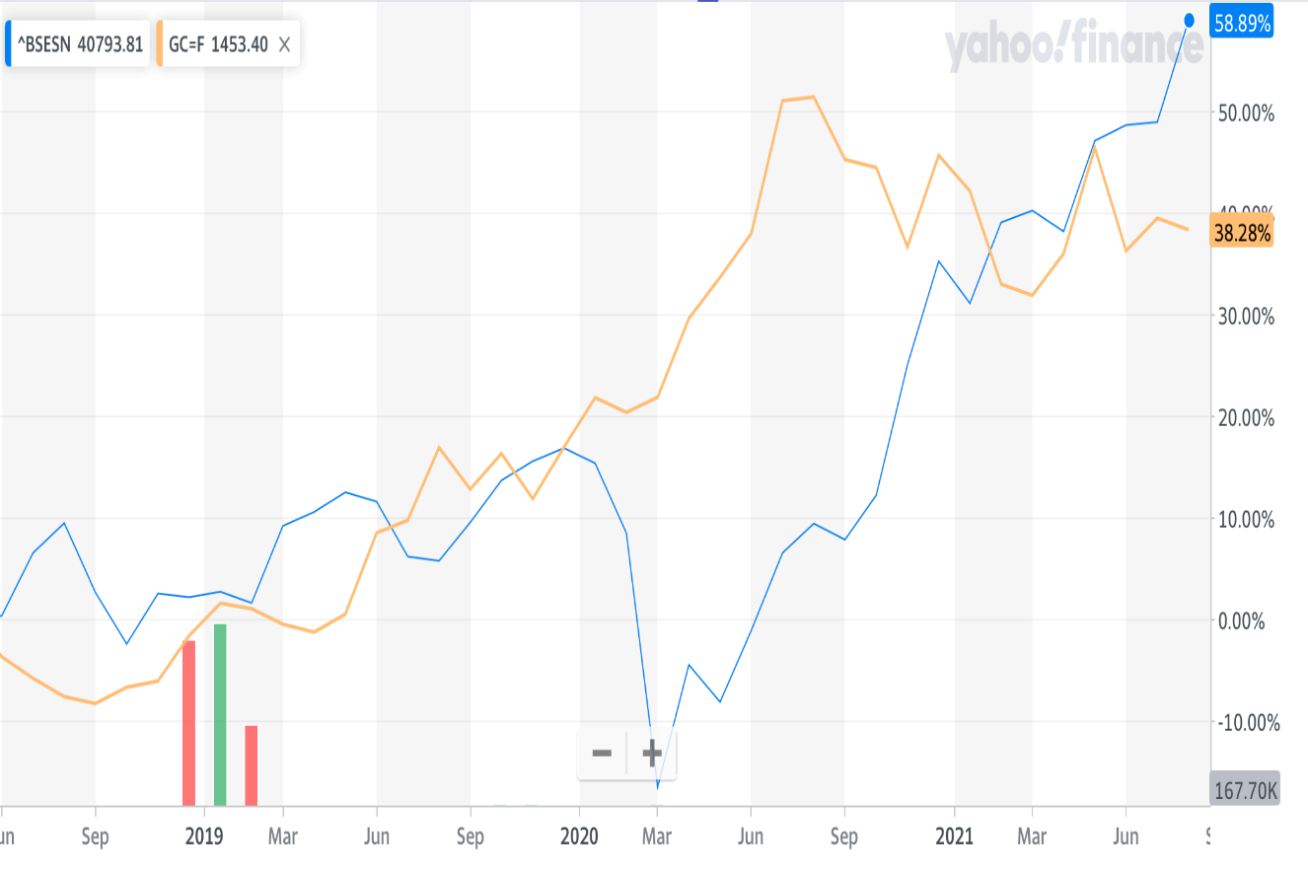
Conclusion
For OLS regression analysis, we are able to determine that cases, nation wide lockdown, investments made by Foreign Institutional Investors, exchange rate and the bond yield have statically significant impact on the value of Sensex.
In situations when there is high uncertainty of the performance of a company, investors resort to investing in pulling out their money from the stock market leading to decline in the performance of Sensex. In such times investors prefer to invest in commodity market which has lower risk as compared to the equity market.

Slide 25
Future scope of this analysis
Currently we have done the analysis for first wave of COVID. Do improve the analysis we can also include second wave data and do piecewise linear regression to get better estimates.
We have considered only national lockdown as a binary variable. To have a better relationship between sensex movement and lockdown restrictions in the country we should also capture information for partial lockdown as well as different phases of unlock in the country.
Due to limitation of data we have also not considered in qualitative factors such as investor sentiment, political stability, corporate news in our analysis. These factors can be included to get better estimates for the independent variables.

Slide 26
Thank you

Slide 27
Data source
https://finance.yahoo.com/quote/%5EBSESN/history/
https://covid19.who.int/?adgroupsurvey={adgroupsurvey}&gclid=CjwKCAjw95yJBhAgEiwAmRrutGT5NivPp73McXzoi5ioPxI0b61axxcei53neTUVPNFvcPIaD9AJMBoCy1QQAvD_BwE
https://www.macrotrends.net/2516/wti-crude-oil-prices-10-year-daily-chart
https://www.cdslindia.com/publications/FIIDailyData.aspx
https://www.eia.gov/dnav/pet/hist/rbrteD.htm
https://in.investing.com/rates-bonds/india-3-month-bond-yield

Slide 28
Data Collection & Modelling
Data Collection
5.297*0.1362= 0.72. cases
Results of the analysis shows that below variables have significant impact on Sensex
Cases
Lockdown
DII
Erate
Nasdaq
Bond_yield
$$Sensex=6.44e^{+04} −4.14e^{−2}∗ Cases −1.34 e^{3}∗Lockdown−1.88e^{1}∗OilPrice+$$
$1.35e^{−1}∗FII −9.06e^{+2}ex_rate+3.48Nasdaq$+$1.88∗e^{+3}$

Slide 29


Suspension of services of Indian Railways and all flight operations. ​
Nationwide lockdown(Phase 1)(25 March –14 April)
Restrictions lifted from small retail shops. Shop could open with 50% staff.
Nationwide Lockdown Phase 3 (4 May – 17 May).
Approval to begin distribution of vaccines
18+ vaccination drive
25 March, 2020
25 April 2020
4 May, 2020
September 2020,
1 May 2021
27608.8
26499.81
31277.11
31659.04
32311.04
32748.14​
31248.26
38176.86
49061.22
48356.01
23 March, 2020
14 April 2020
29 April, 2020
18 May, 2020
16 January 2021
Nationwide Lockdown Phase 4 Relaxation allowed except in red zone which further divided into containment zone and buffer zone.
Suspension of services of Indian Railways and all flights operations
Nationwide lockdown in Green, orange and Red Zones
Interstate transportation allowed
for stranded persons only
Vaccination program started

